Slide 1
Introduction to AI/ ML

Slide 2
Agenda
What is Machine Learning
Classical Programming vs Machine Learning
AI, ML, DL and Data Sciences Explained
Why should I learn Machine Learning? Where is AI heading?
Applications of AI
Steps to perform Machine Learning
Supervised and Unsupervised Learning

Slide 3
What is Machine Learning
“Machine learning is the field of study that gives computers the ability to learn without being explicitly programmed”
— Arthur L. Samuel, AI pioneer, 1959

Slide 4
Classical Programming vs Machine Learning
Classical Programming
Data
Computer
Output
Program
Machine Learning
Data
Computer
Program
Output

Slide 5
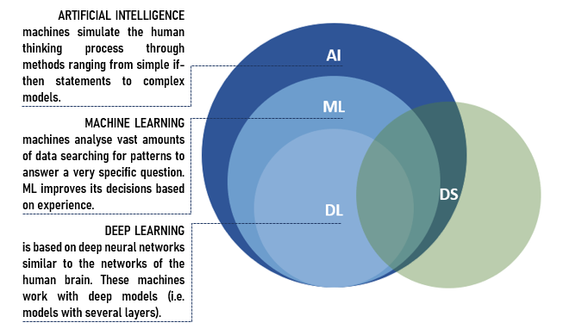
AI, ML, DL and Data Science Explained

Slide 6
Why should I learn ML? Where is AI heading?
The global machine learning market was valued at $1.58B in 2017 and is expected to reach $20.83B in 2024, growing at a CAGR of 44.06% between 2017 and 2024
According to SimplyHired.com, the average machine learning engineer salary is $142,000.An experienced machine learning engineer can earn up to $195, 752
Reference:-https://www.forbes.com/sites/louiscolumbus/2020/01/19/roundup-of-machine-learning-forecasts-and-market-estimates-2020/

Slide 7
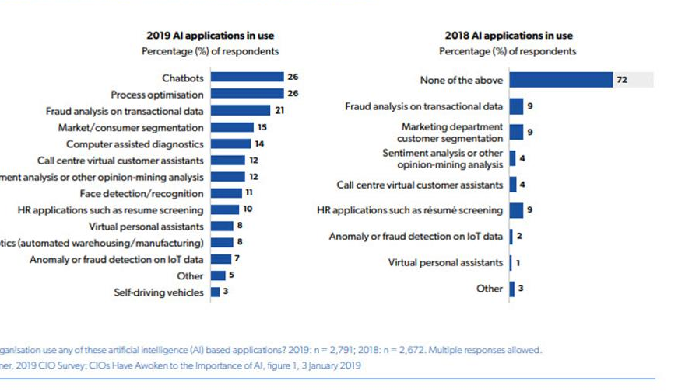
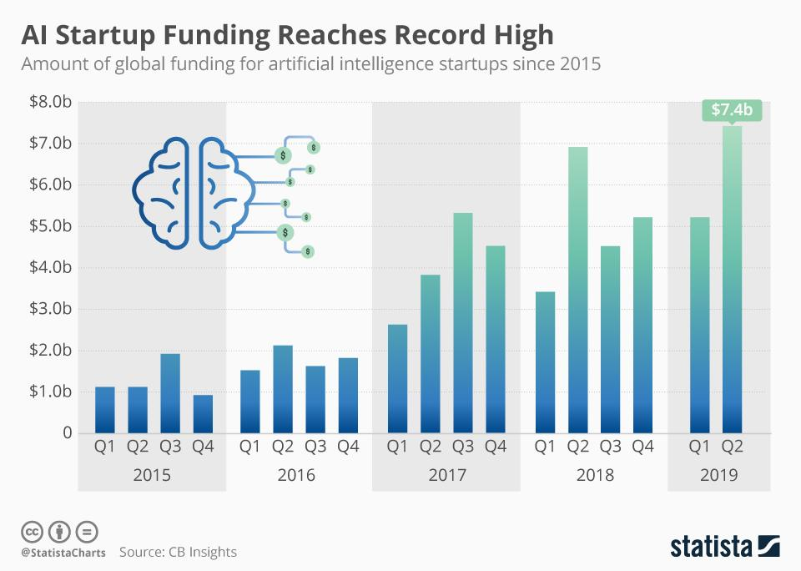
Why should I learn ML? Where is AI heading?

Slide 8
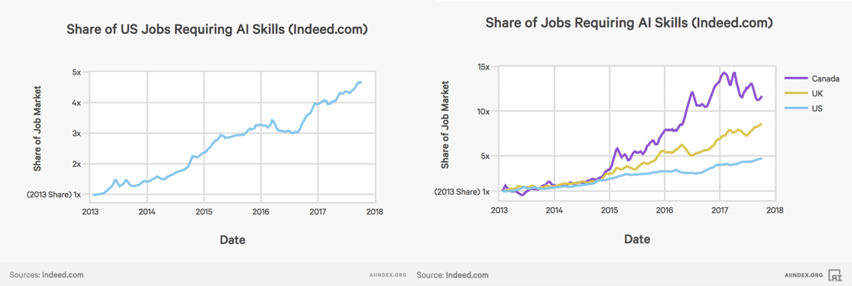
Why should I learn ML? Where is AI heading?

Slide 9
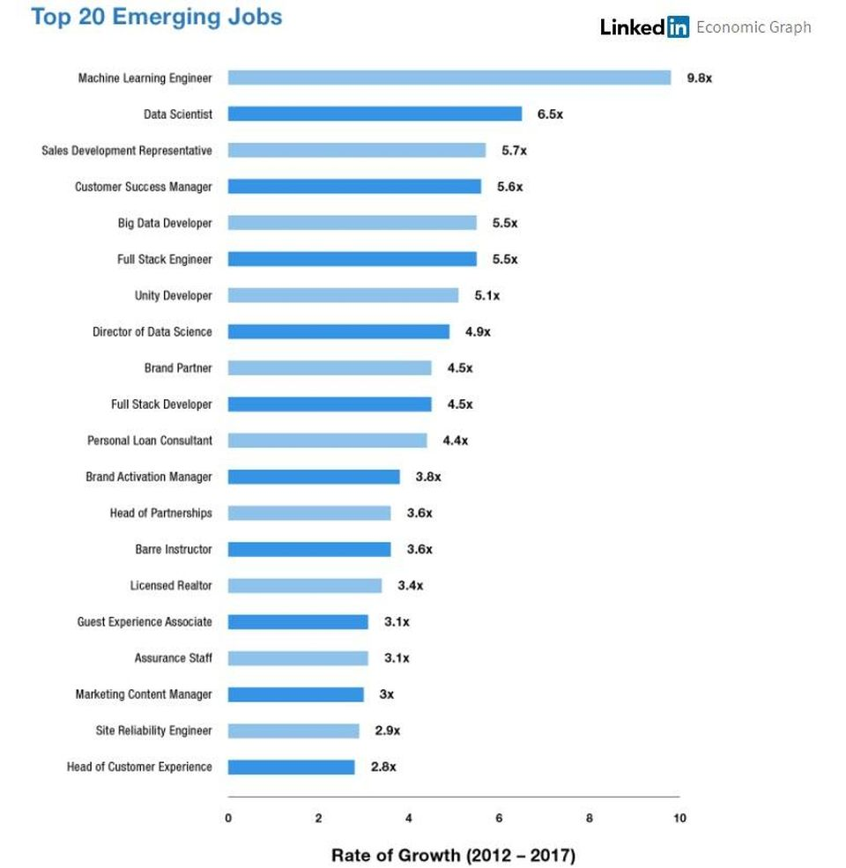
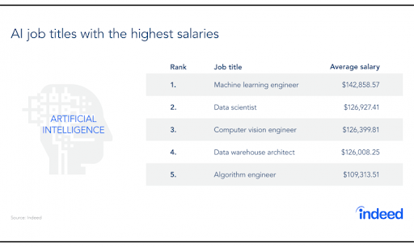
Why should I learn ML? Where is AI heading?

Slide 10
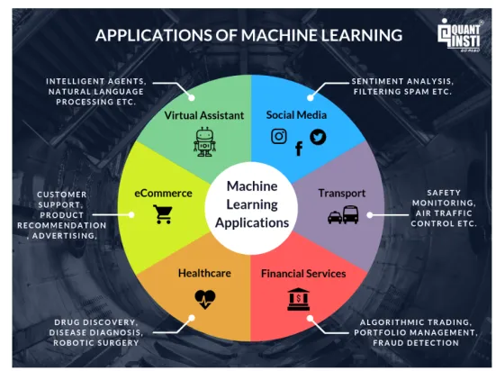
Applications of Machine Learning

Slide 11
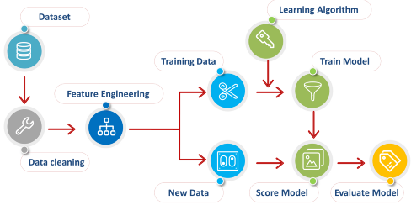
Steps to perform Machine Learning

Slide 12
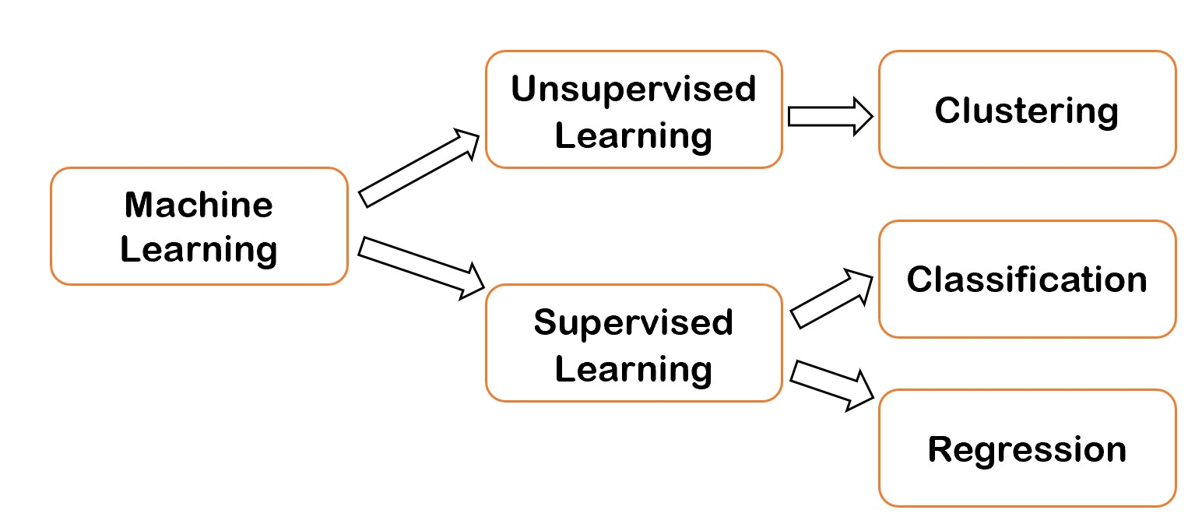
Supervised and Unsupervised Techniques

